Slide 1
Course: Digital Logic Design
Lecture No.02
BSAI/SE – 2nd
Instructor: Dr. Tahir Ejaz

Slide 2


Slide 3
Lecture Contents
Arithmetic Operations
  Add, Subtract, Multiply, Division
Signed Binary Number
  Signed Magnitude
  1’s & 2’s Complement
Logic Gates
  AND, OR, NOT, NOR, XOR, XNOR
Logic Gates Operation

Slide 4
Arithmetic Operations

Slide 5
Operation in the Number System
Operation on Numbers
  Addition
  Multiplication
  Subtraction
  Division

Slide 6
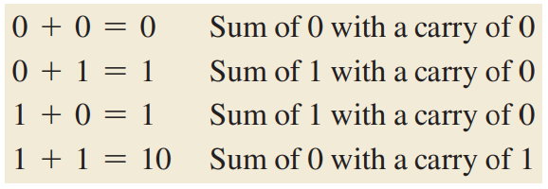
Operation in the Number System
Binary Addition:

Slide 7
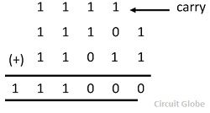
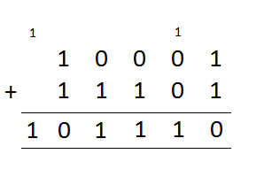
Operation in the Number System
Binary Addition:

Slide 8
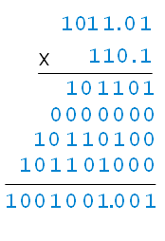
Operation in the Number System
Multiplication in Binary:

Slide 9
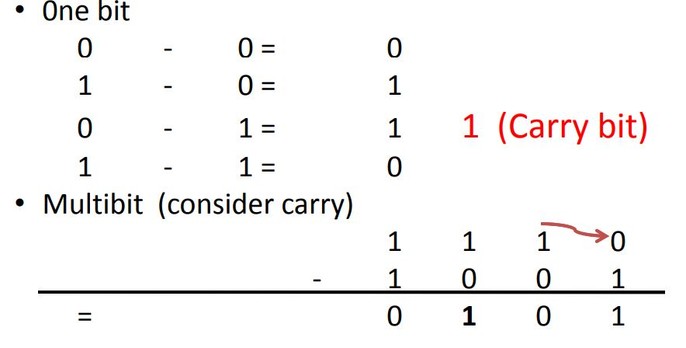
Operation in the Number System
Subtraction in Binary:

Slide 10
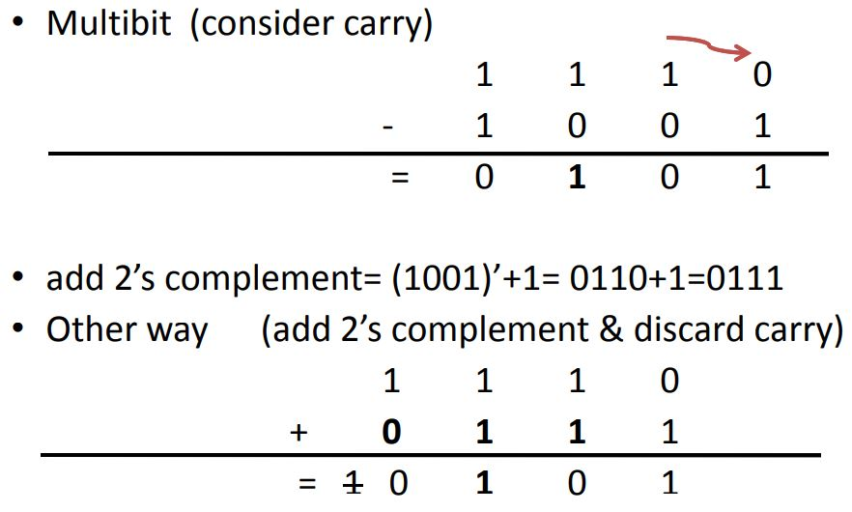
Operation in the Number System
Subtraction in Binary:

Slide 11
Signed Binary Numbers

Slide 12
Representation of Sign in Binary
Signed magnitude
1’s complement
2’s complement
9’s Complement
10’s Complement

Slide 13
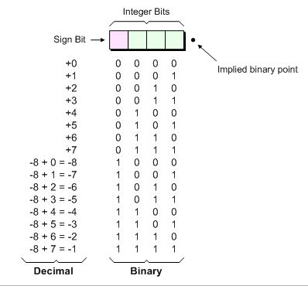
Signed Magnitude
Ex. 4-bit Signed Magnitude

Slide 14
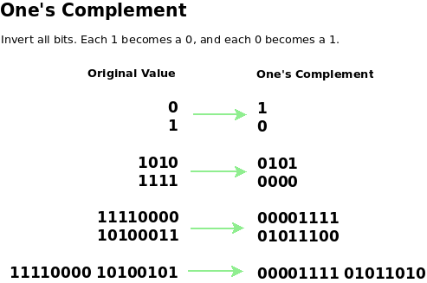
1’s Complement

Slide 15
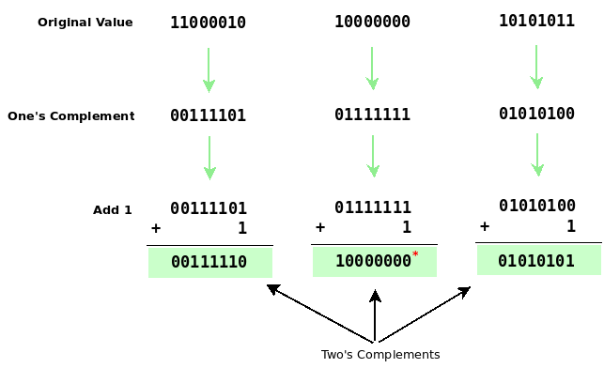
2’s Complement

Slide 16
2’s Complement (Examples)
Taking 2’s Complement
2’s Complement Form/Notation/ Representation

Slide 17
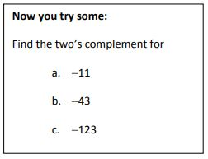
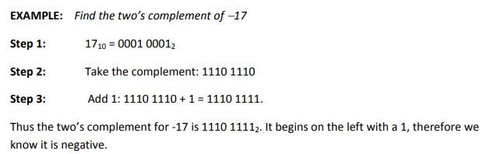
2’s Complement (Examples)
Taking 2’s Complement:
  Flip the number and add 1

Slide 18
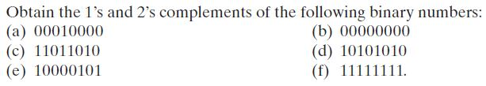
2’s Complement (Examples)
Practice Problems:
  Represent in 2’s Complement
    27, -17, -49
  Add 37 & 13
  Subtract 9 from 21
  Subtract 17 from 13

Slide 19
Logic Gates

Slide 20
Logics Gates
Commonly used Logic Gates are:
  Inverter (NOT Gate)
  AND Gate
  OR Gate
  NAND Gate
  NOR Gate
  XOR Gate
  XNOR Gate

Slide 21
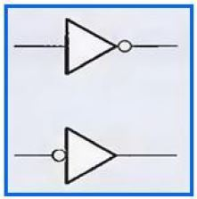
Logic Gates
Inverter (NOT Gate):
  The inverter (NOT Gate) performs the operation called inversion or complementation.
  The inverter changes one logic level to the opposite level.
  In terms of bits, its changes a 1 to a 0 and 0 to a 1.
  Standard logic symbols for the inverter is shown in the figure below:

Slide 22
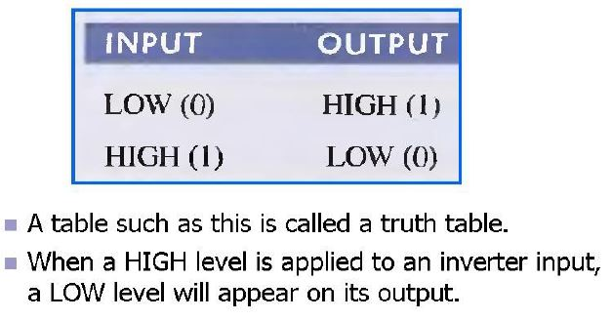
Logic Gates
Inverter truth table:

Slide 23
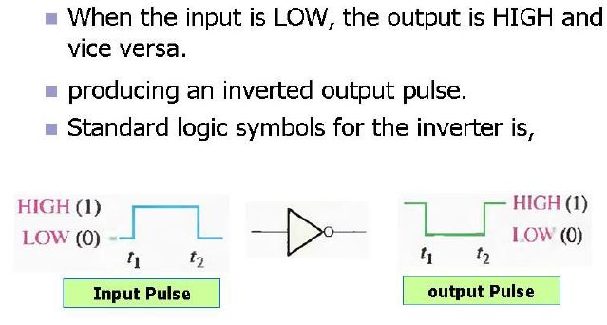
Logic Gates
Inverter:

Slide 24
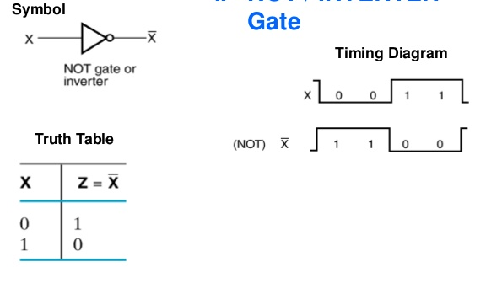
Logic Gates
Timing diagram of Inverter:

Slide 25
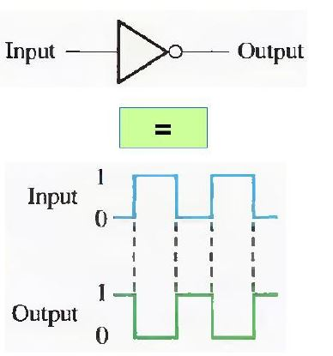
Logic Gates
Inverter:

Slide 26
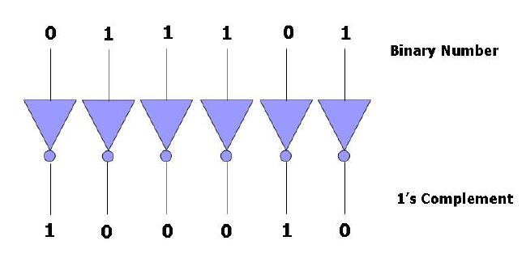
Logic Gates
Inverter (Application):

Slide 27
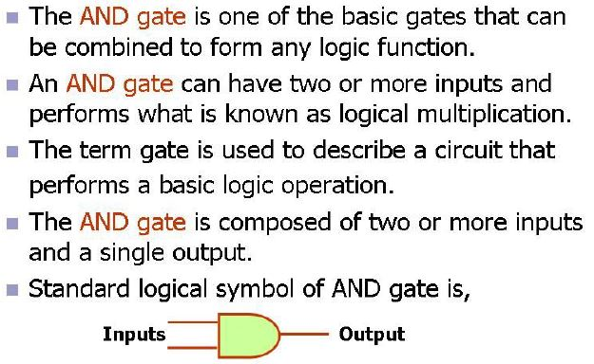
Logic Gates
AND Gate:

Slide 28
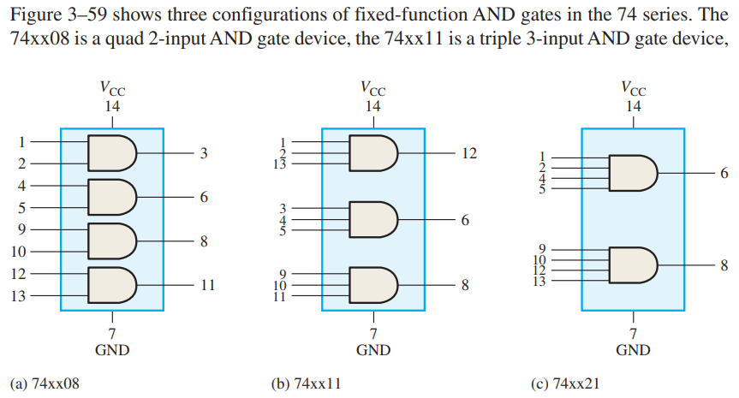
Logic Gates (AND)

Slide 29
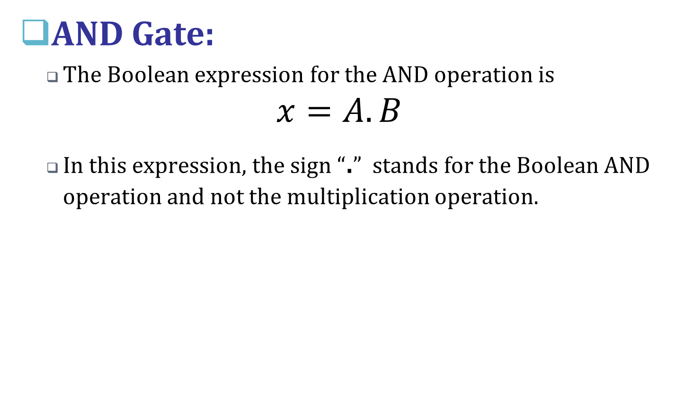
Logic Gates

Slide 30
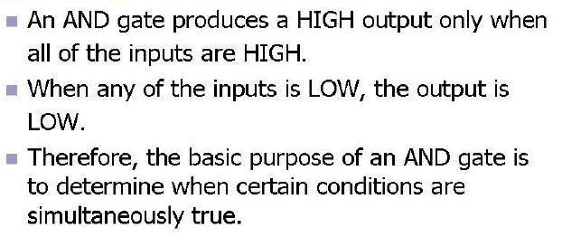
Logic Gates
Operation of an AND Gate:

Slide 31
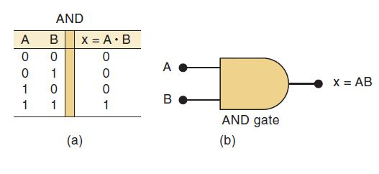
Logic Gates
Truth Table for AND Operation:

Slide 32
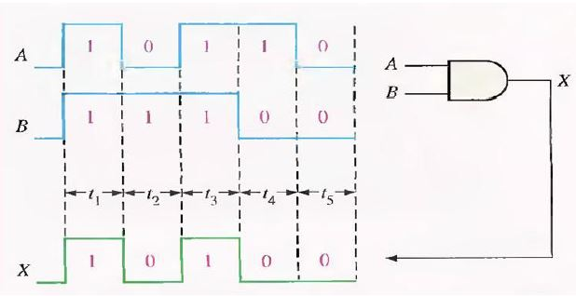
Logic Gates
Timing Diagram of AND Gate:

Slide 33
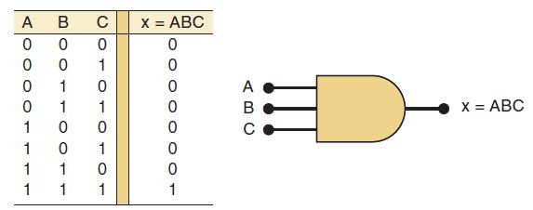
Logic Gates
Truth Table for AND Operation:

Slide 34
Logic Gates
Summary of AND Operation:
  The AND operation is performed the same as ordinary multiplication of 1s and 0s.
  An AND gate is a logic circuit that performs the AND operation on the circuit’s inputs.
  An AND gate output will be 1 only for the case when all inputs are 1; for all other cases, the output will be 0.
  The expression x = AB is read as “x equals A AND B.”

Slide 35
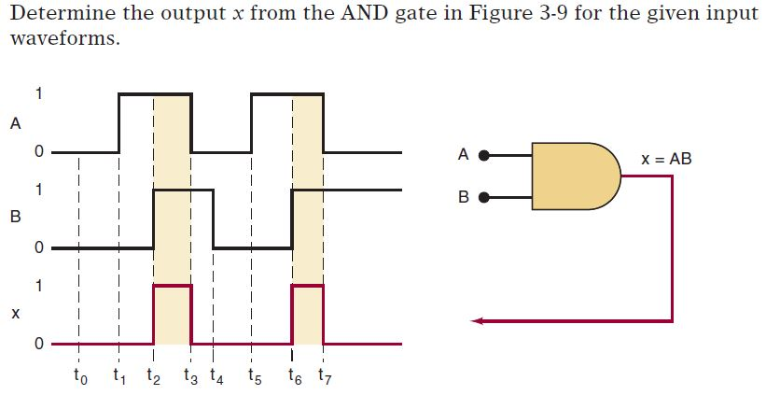
Logic Gates
AND Gate Examples:

Slide 36
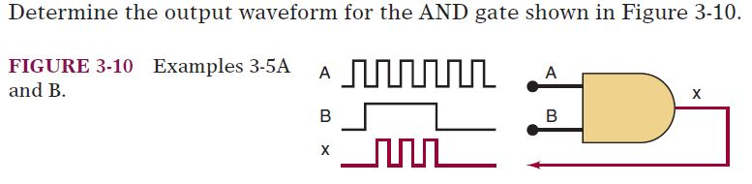
Logic Gates
AND Gate Examples:

Slide 37
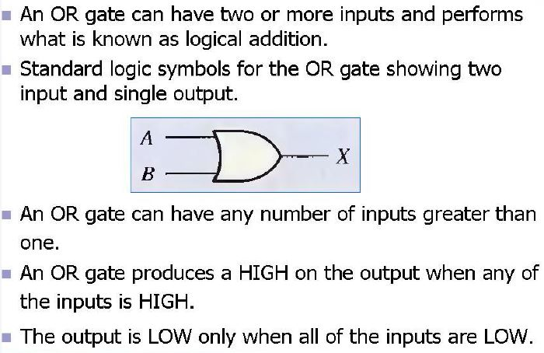
Logic Gates
OR Gate:

Slide 38
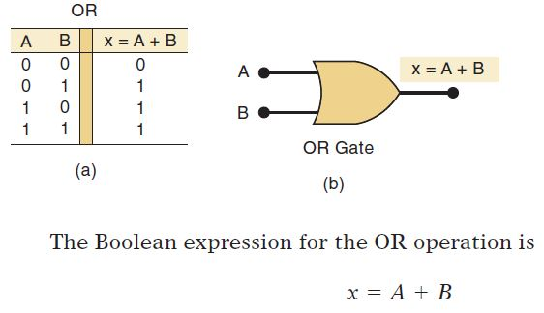
Logic Gates
OR Gate:

Slide 39
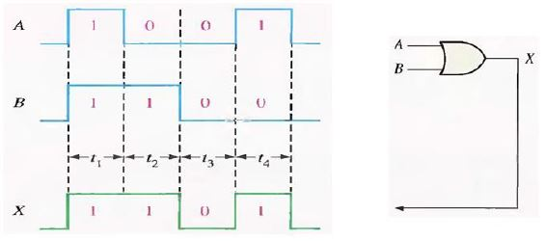
Logic Gates
OR Gate Timing Diagram:

Slide 40
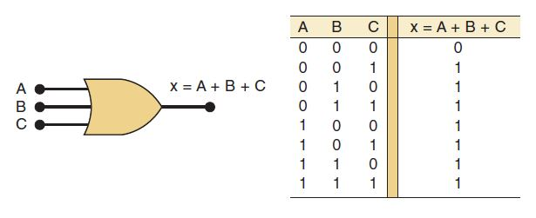
Logic Gates
OR Gate:

Slide 41
Logic Gates
Summary of OR Operation:
  The important points to remember concerning the OR operation and OR gates are:
  The OR operation produces a result (output) of 1 whenever any input is a 1. Otherwise, the output is 0.
  An OR gate is a logic circuit that performs an OR operation on the circuit’s inputs.
  The expression x = A + B is read as “x equals A OR B.”

Slide 42
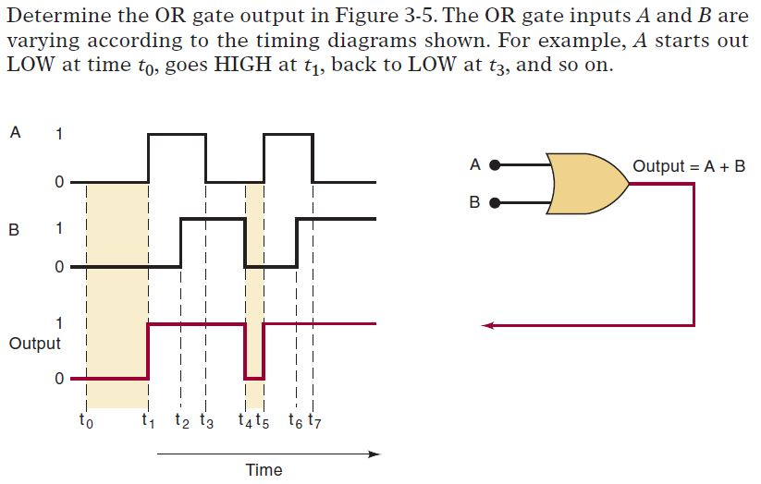
Logic Gates
OR Gate (Examples):

Slide 43
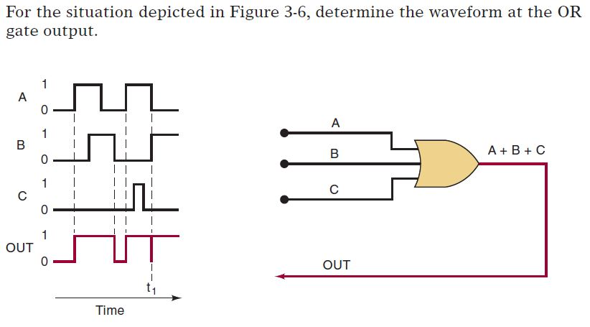
Logic Gates
OR Gate (Examples):

Slide 44
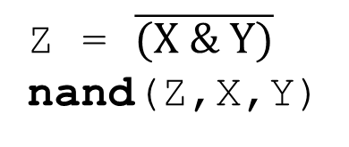
Logic Gates
NAND Gate:
X Y Z
0 0 1
0 1 1
1 0 1
1 1 0
X
Z
Y

Slide 45
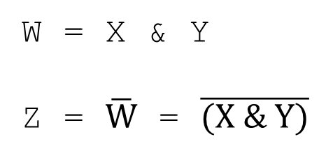
Logic Gates
NAND Gate:
NOT-AND
X Y W Z
0 0 0 1
0 1 0 1
1 0 0 1
1 1 1 0
X
W
Z
Y

Slide 46
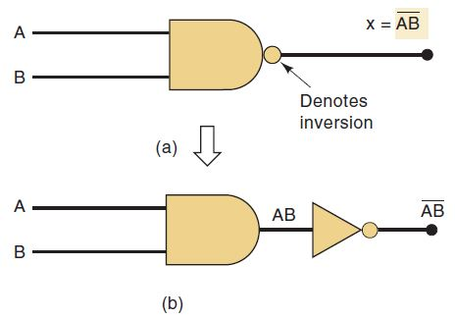
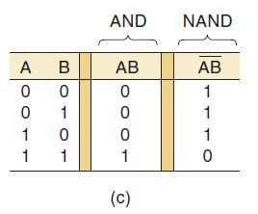
Logic Gates
NAND Gate:

Slide 47
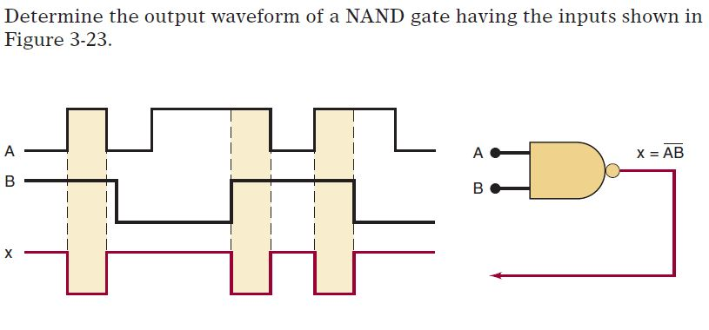
Logic Gates
NAND Gate: (Example)

Slide 48
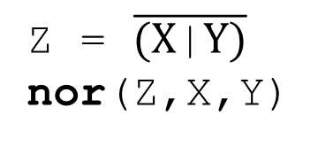
Logic Gates
NOR Gate:
NOR
X Y Z
0 0 1
0 1 0
1 0 0
1 1 0
X
Z
Y

Slide 49
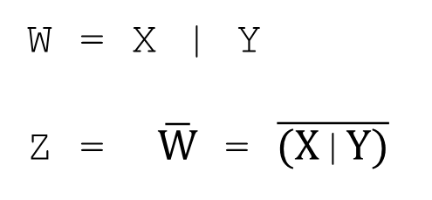
Logic Gates
NOR Gate:
NOT-OR
X Y W Z
0 0 0 1
0 1 1 0
1 0 1 0
1 1 1 0
X
W
Z
Y

Slide 50
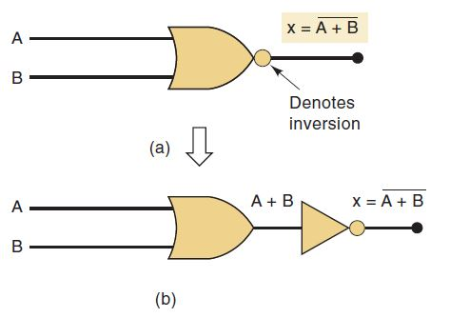
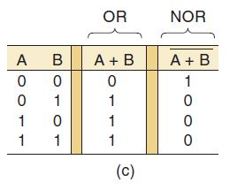
Logic Gates
NOR Gate:

Slide 51
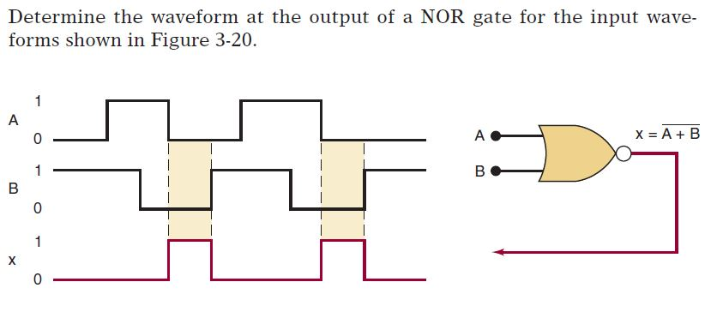
Logic Gates
NOR Gate: (Example)

Slide 52
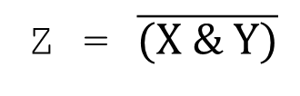
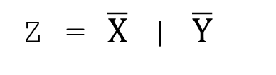
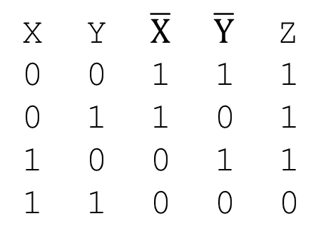
Logic Gates
NAND Gate = NOR Gate:
X
Z
X
Z
=
Y
Y
X Y W Z
0 0 0 1
0 1 0 1
1 0 0 1
1 1 1 0

Slide 53
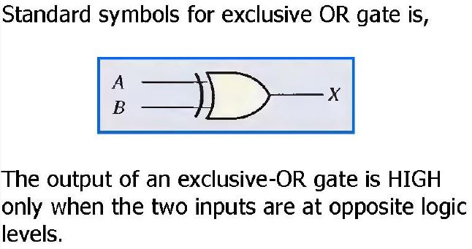
Logic Gates
Exclusive OR Gate: (XOR)

Slide 54
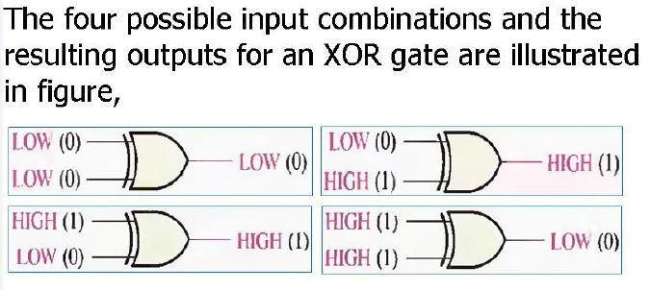
Logic Gates
Exclusive OR Gate:

Slide 55
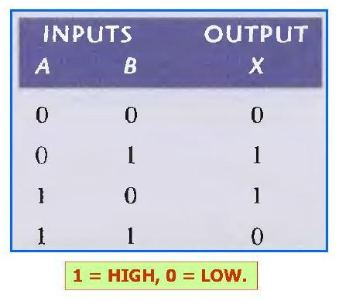
Logic Gates
Exclusive OR Gate (Truth Table):

Slide 56
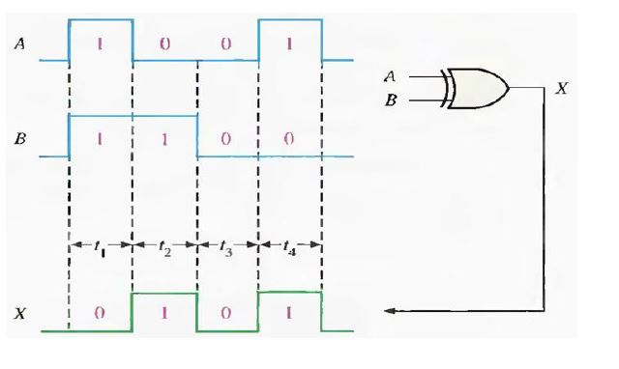
Logic Gates
Exclusive OR Gate (Timing diagram):

Slide 57

Logic Gates
Exclusive OR Gate: (XOR) Application

Slide 58

Logic Gates
Exclusive NOR Gate: (XNOR)

Slide 59

Logic Gates
Exclusive NOR Gate: (XNOR)

Slide 60

Logic Gates
Exclusive NOR Gate: (XNOR) Truth Table

Slide 61

Logic Gates
Operational Waveform of XOR & XNOR

Slide 62

Logic Gates (Summary)

Slide 63


Logic Gates (Tasks)
Determine the faulty gates given below by analyzing the timing diagrams.

Slide 64
Lecture Summary
Arithmetic Operations
  Add, Subtract, Multiply, Division
Signed Binary Number
  Signed Magnitude
  1’s & 2’s Complement
Logic Gates
  AND, OR, NOT, NOR, XOR, XNOR
Logic Gates Operation

Slide 65
Useful Videos
https://www.youtube.com/watch?v=E5V9zBBAfWM
https://www.youtube.com/watch?v=n1LS6AOoGVo
https://www.youtube.com/watch?v=_yHo2qq82P0

Slide 66
Thank You !

